Slide 1
SchedulEd
CS 691 Asynchronous
Capstone
Team 1
Professor Henry Wong
Spring 2025

Slide 2

Agenda T
Team Member Roles and Responsibilities
Improvements
Project Description
Team Working Agreement
Schedule
Personas
MVP
Technologies/API
Algorithms
Sprint 1 Summary
Product Backlog/Sprint 2 Test cases/Sprint 2 Stories
Sprint 2 Completed/Not Completed
Metrics/Team Velocity
Burndown Charts
Retrospective
Sprint 3 Planning
Project Demo and APIs
Group Wiki Page

Slide 3



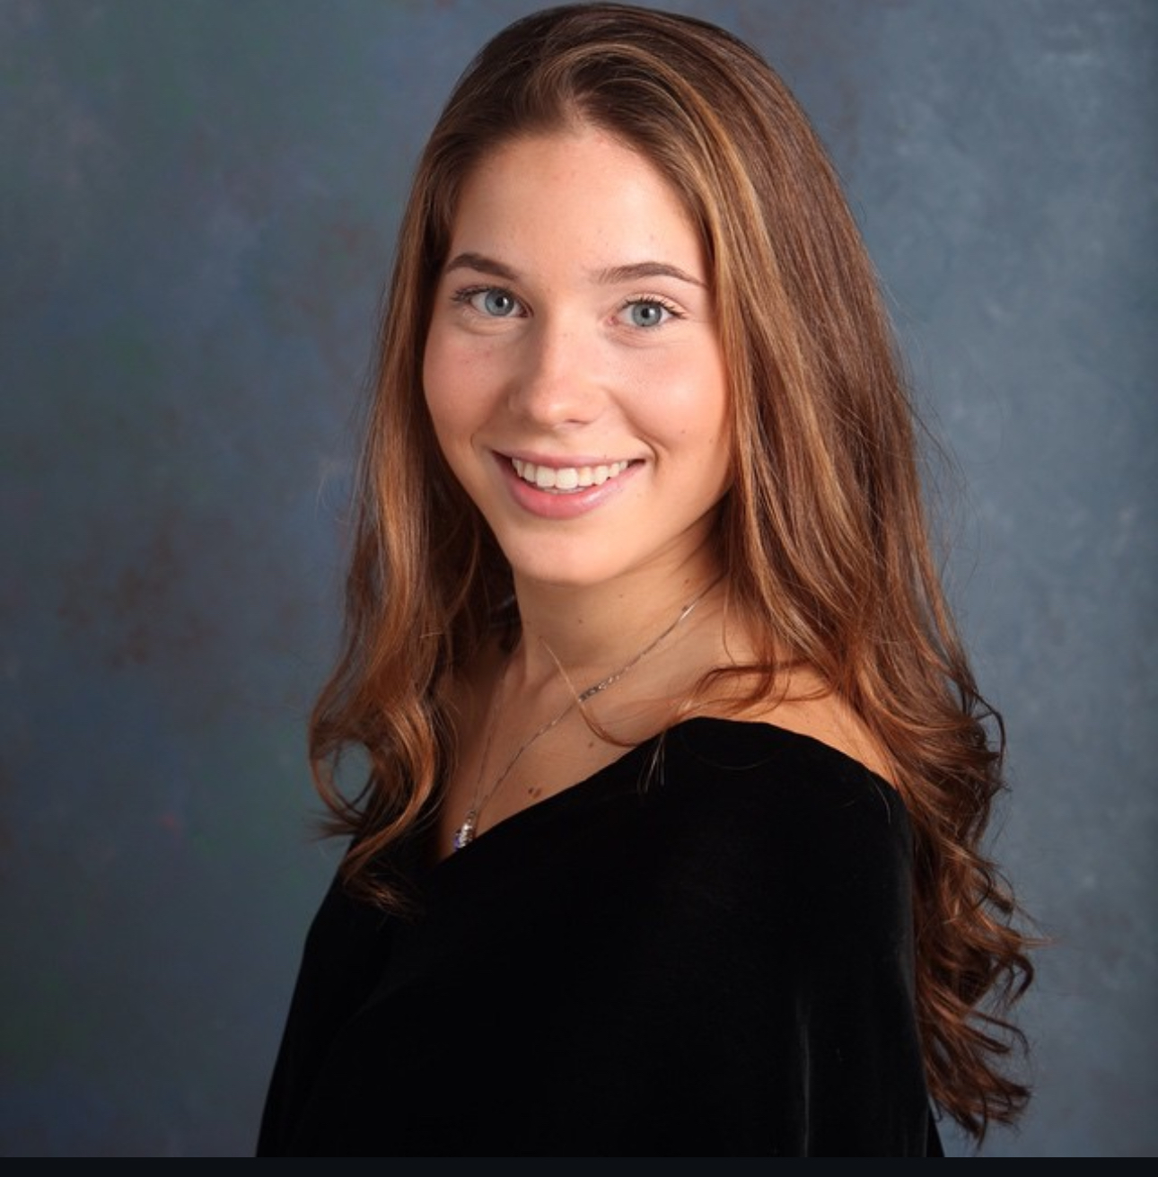

Team Members T
Sabrina Scaccio: Scrum Master / Developer
Thomas D'Anna: Front End Developer
Justin Rivera:
Front End Developer
Victor Zapata:
Back End Developer
Michael Silva:
Back End Developer

Slide 4
Improvements S
First sprint where we focused mainly on code, rather than the planning. We were able to split up front-end and back-end between team members and then join the code in one of our meetings.
We had more meetings broken off from larger group dependent on what team members were working on. Front end team members met separately, and the back-end team did the same.
We were done with different parts of the sprint earlier in the sprint, not leaving things until the last minute.

Slide 5

Project Description S
ScheduleEd is a scheduling app that will assist teachers, parents, and students with the process of booking, managing, and tracking tutoring sessions. This app will focus on alleviating scheduling conflicts among all involved. Often, students have various commitments after school that are hard for the parents to manage. The times of these various extracurricular activities change. This has a trickledown effect on the teachers. This app will allow parents to book with a more flexible approach. They can go week by week, selecting times that work for them and their child. This app will eliminate scheduling conflicts, reduce ineffective communication, and avoid double-bookings and no-shows. In just the tap of a button, parents and students will be able to book, cancel, and reschedule appointments! The app will remind students/parents of their sessions and will allow the tutor to have a better scope at their week. It also will allow the tutor to notify parents of available times, rather than going back and forth, guessing what time will work. This app will aid many teachers, private tutors, and tutoring centers with a way to manage their learning schedule in a much more organized fashion.

Slide 6
Team Working Agreement S
All team communication will occur using Microsoft Teams/I-Message
We remind each other that we are all in this together, and when conflicts do arise, we tackle them as a team and will help guide each other.
Meetings will be held using Microsoft Teams. We will meet weekly on Wednesdays @8:00 pm. We will add meetings as needed, to stay on top of deadlines. Meetings will be about a half hour.
At the beginning of each sprint, we will hold a sprint planning meeting, in which everyone is given their tasks.
Before the sprint is over, we will hold a meeting on our retrospectives.
Each team member will understand their role and what they are responsible for.

Slide 7
Team Working Agreement CONT. S
Everyone will adhere to the due dates and the due date of when we want tasks done, will be discussed at the meeting.
Each team member has their own task but is reminded that we are a team, and things may not go as smoothly for others.
When there are conflicts within your own task, it is required that you tell the team immediately so that they can assist you and there are no delays in due dates.
Each team member is asked to come to the meetings fully prepared with their task.
We will continue to learn through this project and produce new innovative ways to tackle this capstone project.
Final work should be submitted as follows:
The team has reviewed your work
There are no errors within your code
All tasks were tested
Work meets the criteria of the class
Code is uploaded to Github
All aspects of the sprint are complete

Slide 8
Project Schedule
 | Start | End
Sprint 0 | January 21st | February 10th
Sprint 1 | February 11th | March 10th
Sprint 2 | March 11th | April 7th
Sprint 3 | April 8th | May 5th
Weekly Meetings!
Sunday /Wednesday @ 8pm! V

Slide 9

Persona 1 S
Kathy is a private tutor working both online and in-person. While she enjoys teaching, managing her growing client base has become increasingly difficult. She often struggles with overbooking and scheduling conflicts, as manually tracking appointments leads to occasional double bookings or missed sessions. With an automated scheduling system, students could book sessions based on her availability, preventing conflicts and last-minute mix-ups. A student profile feature would help her store session notes and track progress efficiently, ensuring personalized lesson plans for each student.
Kathy - Wants a comprehensive tutor scheduling planner for managing multiple clients.

Slide 10

Persona 2 S
Jake is a 16-year-old high school student juggling multiple tutoring sessions alongside his regular schoolwork and extracurricular activities. He often forgets about scheduled lessons or struggles to find time for rescheduling when conflicts arise. He has a hard time keeping track of assignments and notes from his tutoring sessions, often misplacing important study materials. With automated reminders, he would never miss an appointment, reducing last-minute cancellations and lost study time. A built-in calendar would help him visualize his schedule, ensuring he doesn’t double-book tutoring with other commitments. A session tracking feature would allow him to store lesson notes, assignments, and key takeaways in one place, making it easier to review material when studying.
Jake – Looking for centralized app for managing tutoring sessions and study material

Slide 11

Persona 3 S
Debra is a busy mother of 3, trying to balance her work schedule while ensuring her 10-year-old daughter stays on top of her tutoring sessions. Debra often finds it challenging to keep track of lesson times, and her daughter's overall progress. In the chaotic life of a parent of multiple children, tutoring schedules sometimes slip through the cracks, leading to missed or forgotten sessions. She also struggles to stay updated on what Emily is working on in her sessions, relying on scattered notes from tutors or brief updates from her daughter. A session log feature would provide insight into Emily’s progress, giving Debra access to lesson notes and assignments so she can stay informed and involved in her child’s learning. A tutor scheduling app would be a game-changer for Debra, allowing her to keep all of Emily’s tutoring information in one place.
Debra - Keeping track of child's appointments and progress.

Slide 12
MVP V
Accounts/Firebase Integration
Tag based Search System
Schedule/Book Sessions
Google Integration

Slide 13




Technology M
Frontend
Backend

Slide 14
Firebase Realtime database api V
Used to store user information.
Names
IDS
Role
Used to store schedule information
Start and End Time
People involved
Subject

Slide 15
Algorithm M
Machine Learning Models (Advanced Matching)
A decision tree predicts the best tutor for a student based on their learning style, subject, and past interactions.
Content-Based Filtering
If a tutor has a history of working well with middle school students in "Science," they will be recommended to students within that range.

Slide 16

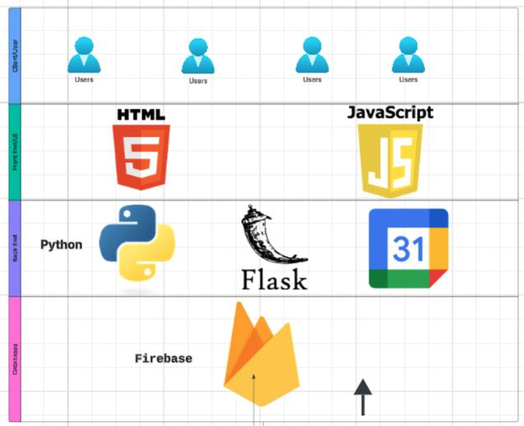
Architecture Diagram

Slide 17
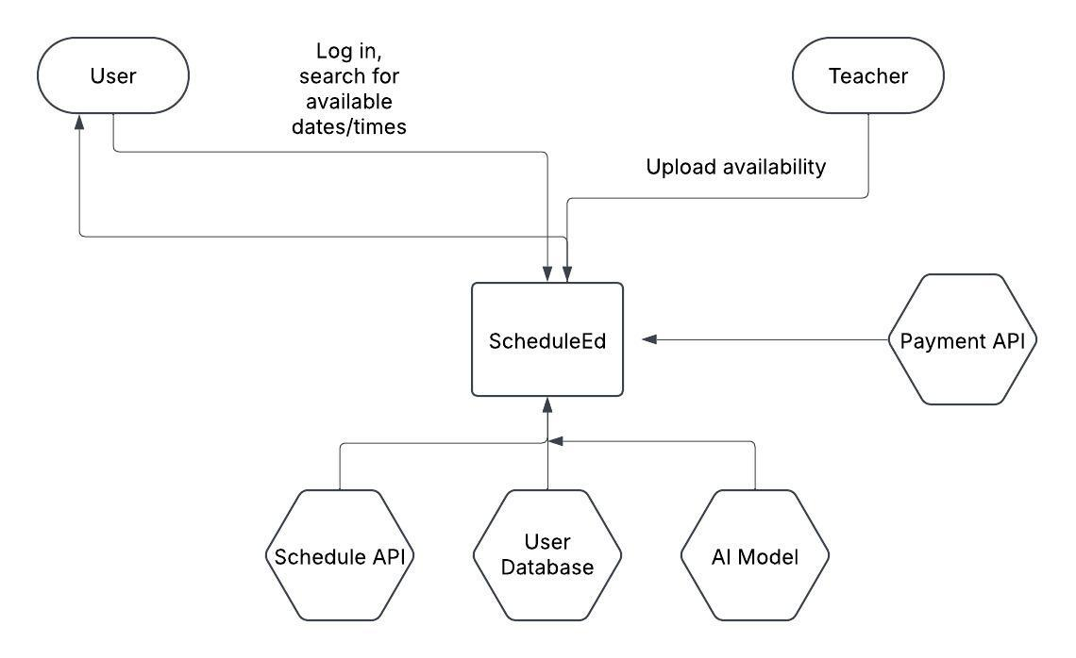
Context Diagram

Slide 18
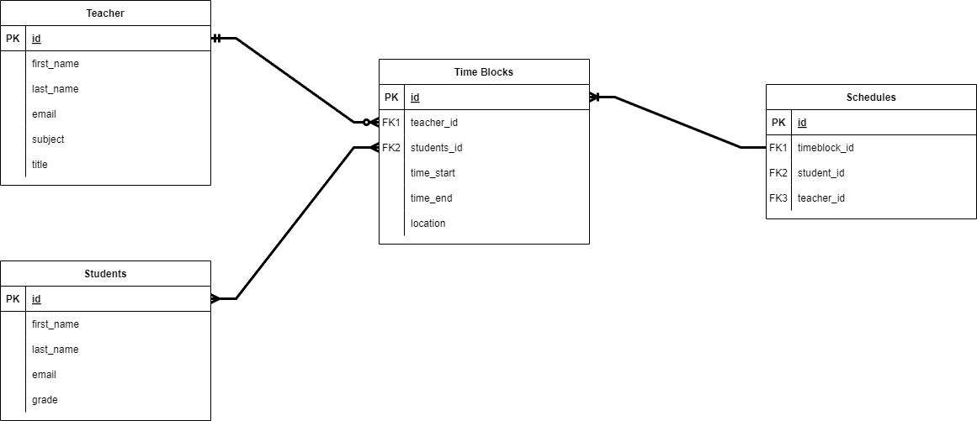
ER Diagram

Slide 19
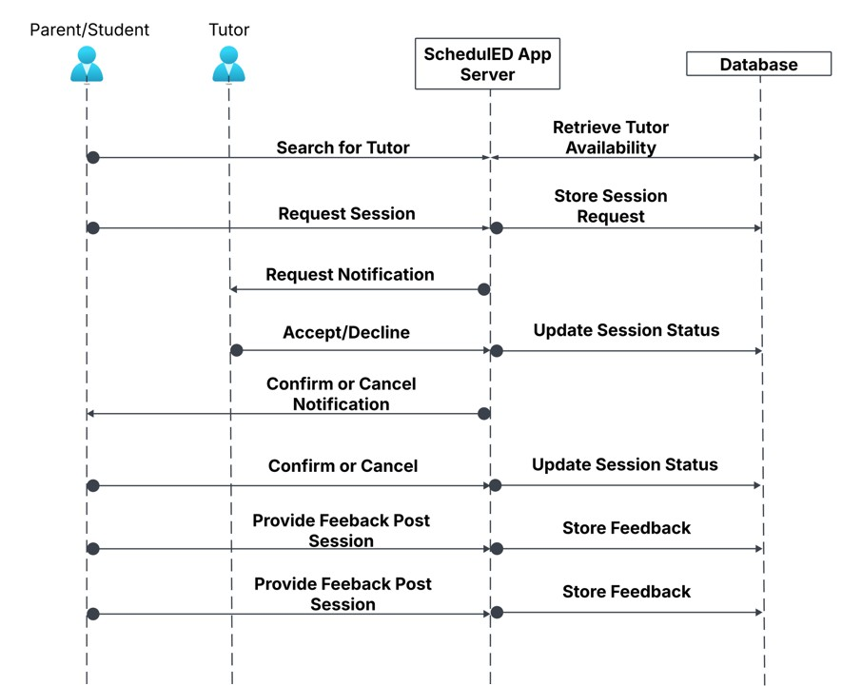
Sequence Diagram

Slide 20
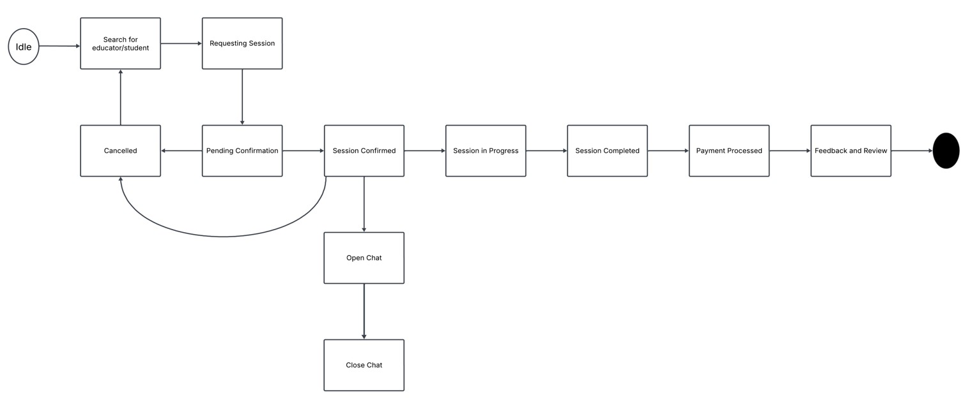
State Diagram

Slide 21
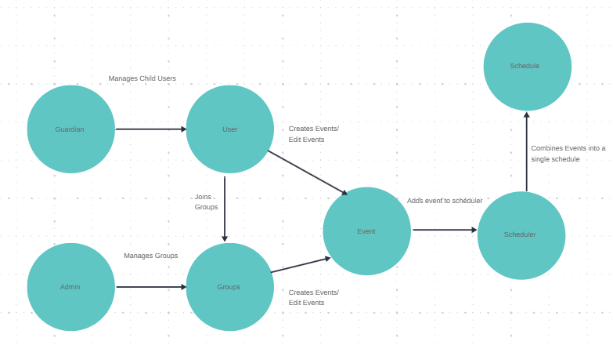
Concept Diagram

Slide 22
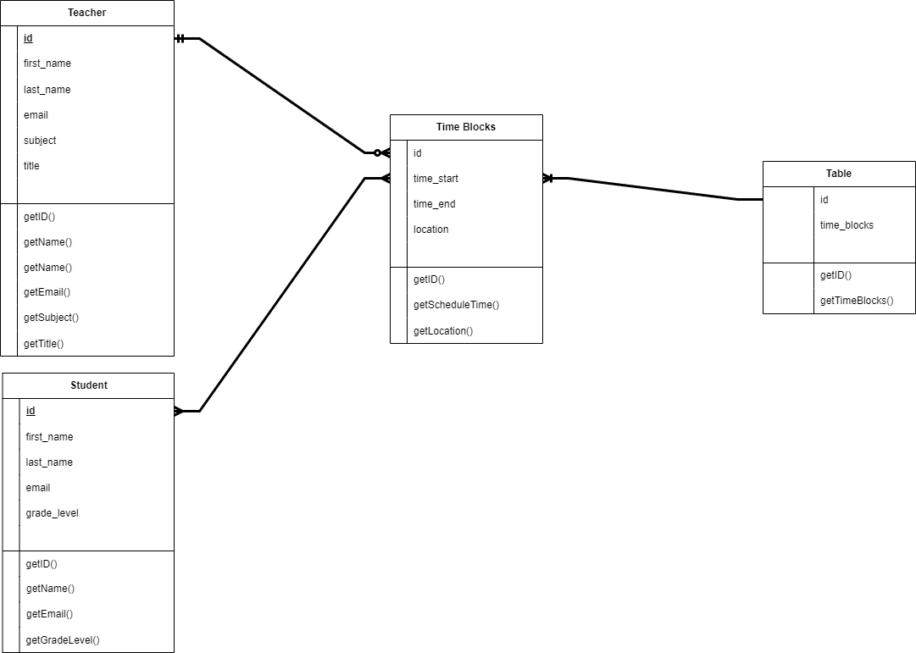
Class Diagram

Slide 23
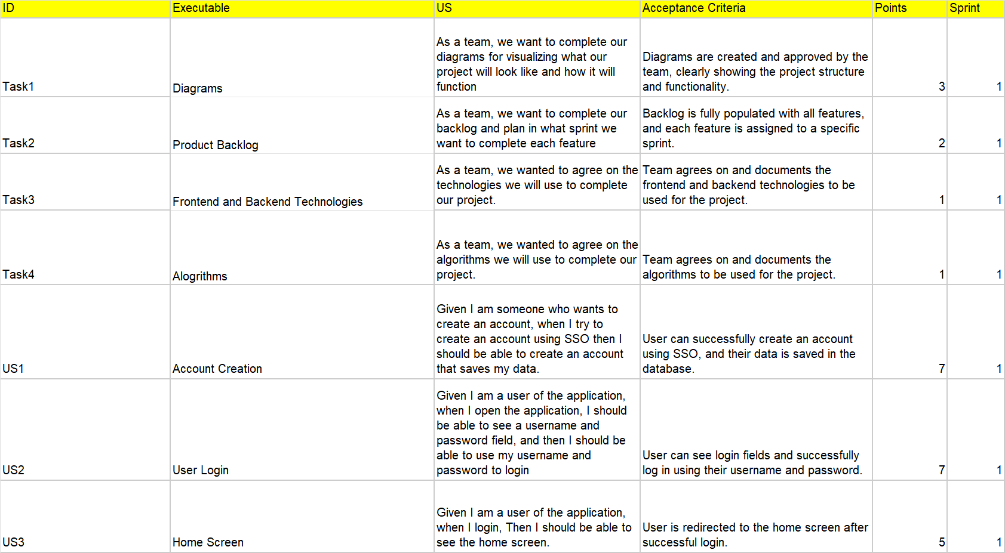
Product Backlog T

Slide 24
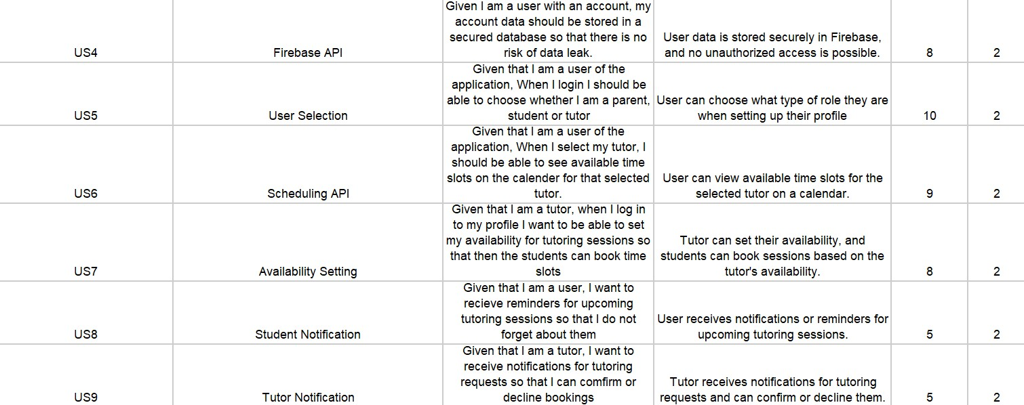
Product Backlog T

Slide 25
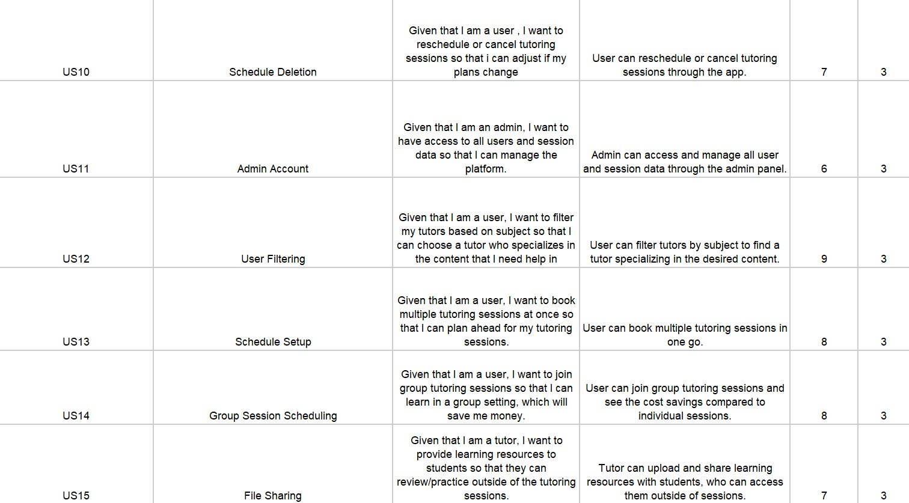
Product Backlog T

Slide 26
Sprint 1 Stories T

Slide 27
SpRint 2 Backlog T

Slide 28
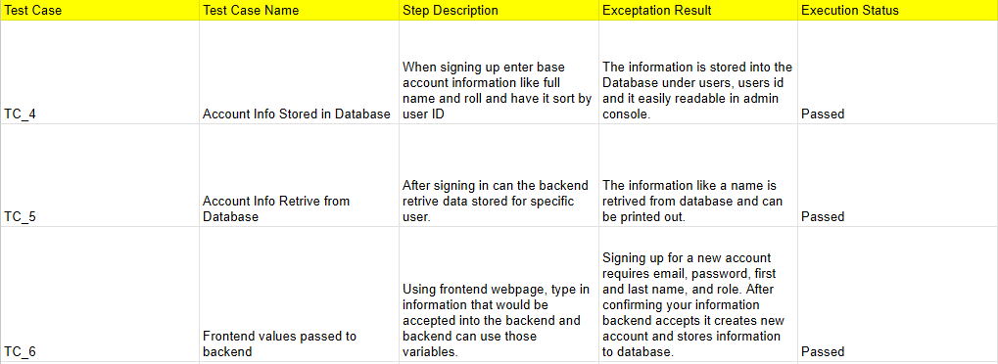
Test Cases Sprint 2 V

Slide 29
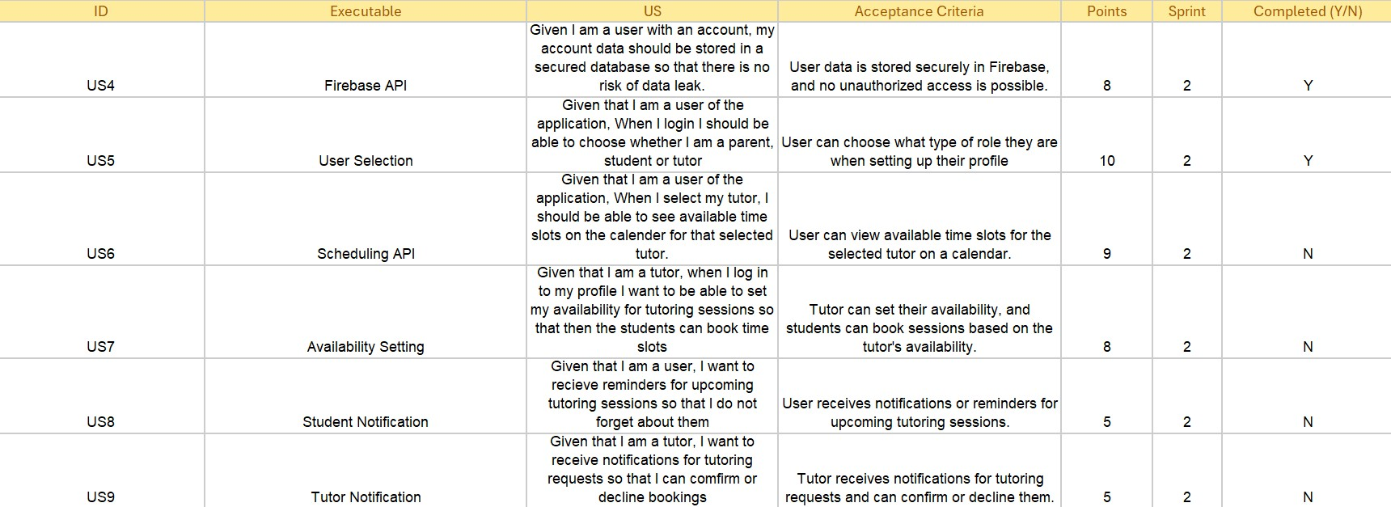
Sprint 2 Stories Completed and not T

Slide 30
Team Velocity 18/45 Story Points Completed J
User data is stored securely in Firebase, and no unauthorized access is possible. Completed 8 Story Points User can choose what type of role they are when setting up their profile. Completed 10 Story Points

Slide 31
Metrics Committed/Completed Ratio J
18 Story points completed of out 45 story points committed = 40% Completed

Slide 32
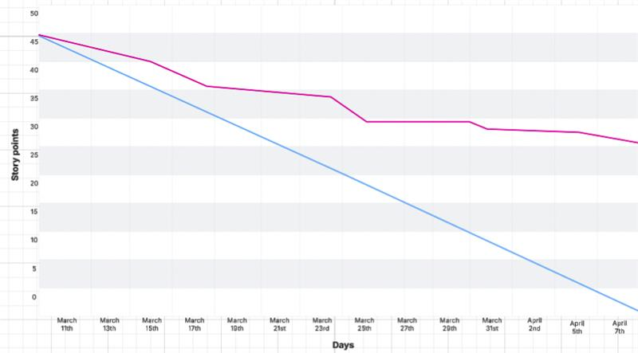
BurnDown Chart Sprint 2 J

Slide 33
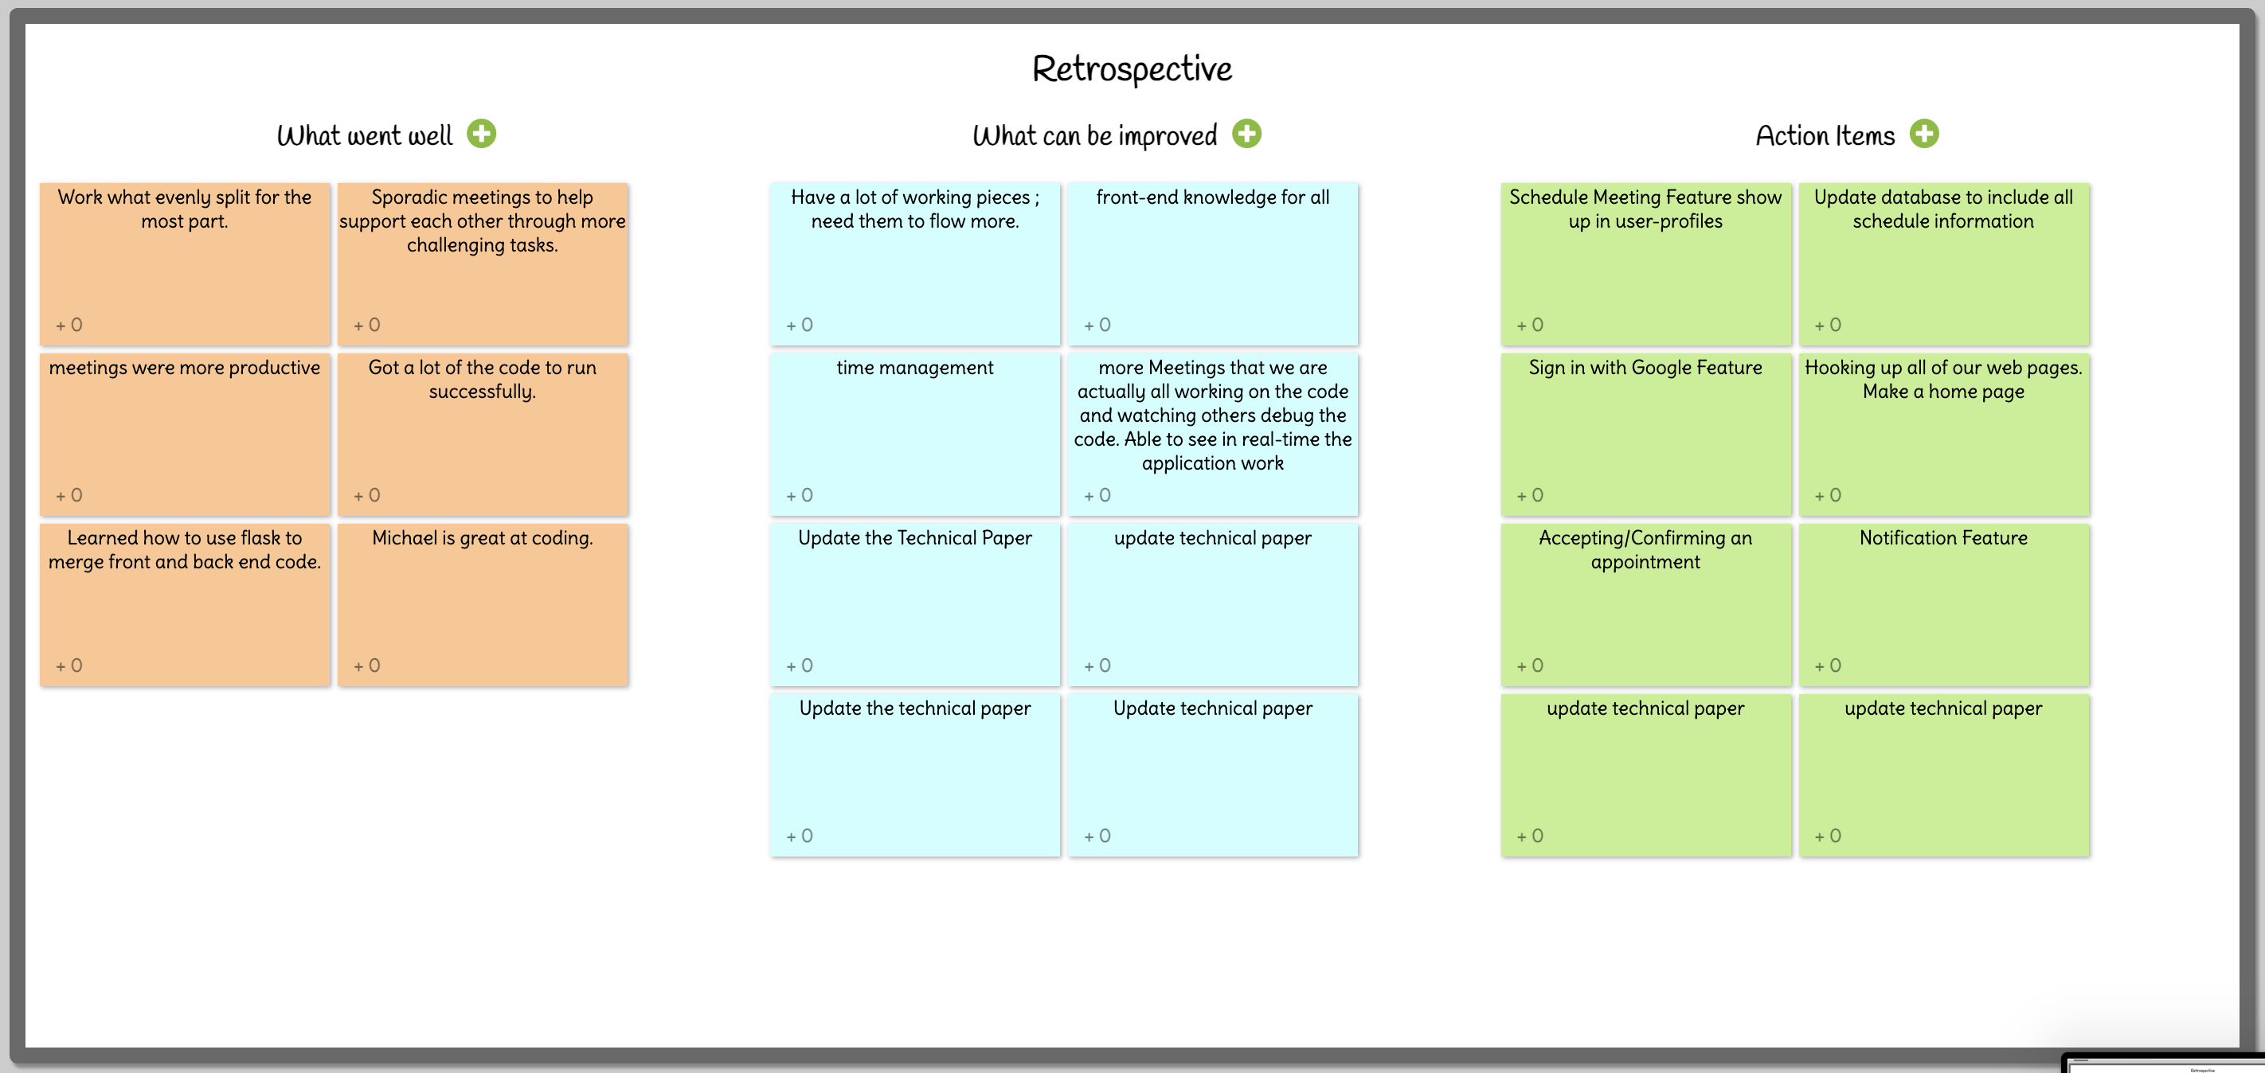
Retrospective S

Slide 34
Sprint 3 Planning T
In Addition to adding the Schedule API, availability setting, and notifications

Slide 35
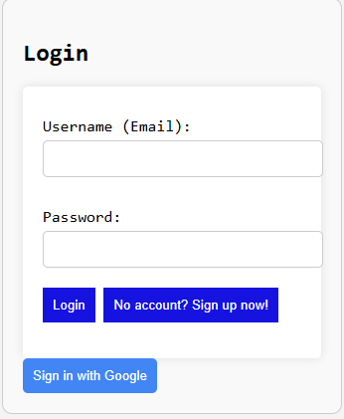
Project Demo M

Slide 36
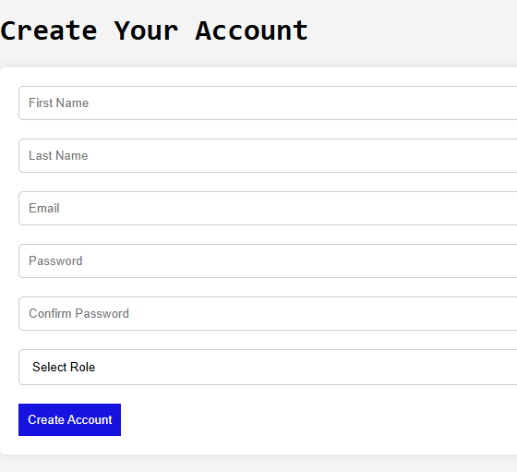
Project Demo M

Slide 37
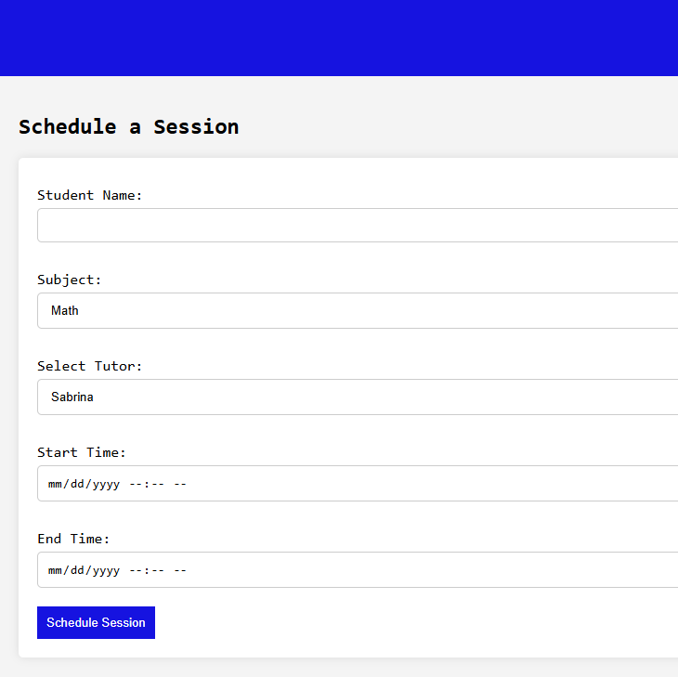
Project Demo M

Slide 38
Group Wiki Link
https://github.com/htmw/2025SA-Team1/wiki

